Slide 1
Juvenile Spacing and Fire Rehab in Chilliwack and Squamish Districts

Slide 2
Agenda
October Budget
Spacing Survey Standards / Fire Assessments
Consultation
Timelines
Lack of skill worker to space
People’s opinions / Spacing standards
Snow
Lessons Learned

Slide 3
Comment regarding the process
Everyone is trying to do their best
Comments are for improving the system

Slide 4
October Budget
Funding for the project was granted in September of 2011
$125,000 for Fire Rehabilitation and Juvenile Spacing Surveys plus
$200,000 for Juvenile Spacing before April 2012

Slide 5
Spacing Survey Standards
I will let Scott Dunn talk about JS Surveys
Criteria for JS stands

Slide 6
Consultation
Consultation is between 30 and 60 days depending on the First Nations Agreements and Issues.
Chilliwack has 40 plus First Nations Groups
Potential Treatment Blocks need to be identified prior to consultation.
Completed by the end of December 2012

Slide 7
Timelines
Budget
Contract for JS or Fire Rehab. surveying
Contractor to survey the blocks and develop prescriptions
Consultation

Slide 8
Timelines continued
Hiring of Auxiliaries
Contract for Juvenile Spacing
Contract monitoring
Contract for RESULTS submission
RESULTS submission
Total time

Slide 9
Workforce Available
Lack of juvenile spacing contracts
Lack of spacers
Some brushing and weeding contractors
Size of the contract

Slide 10
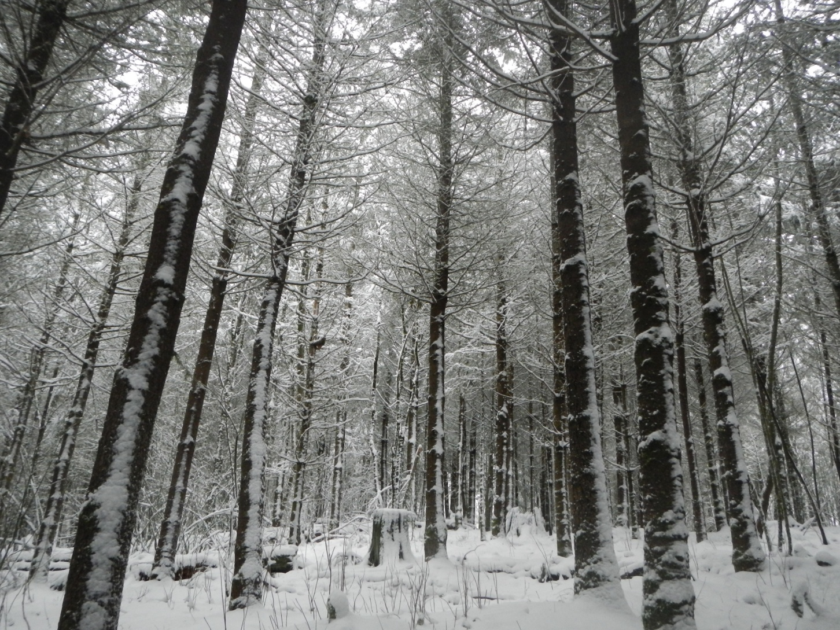
Sample 1 (Vedder)

Slide 11
Professionals Opinions
Everyone has their opinion
Too young / Too old
TFL vs TSA
Densities / Competition (post spacing)
Squamish vs Chilliwack
Post Increment Treatment Assessments (PITA)

Slide 12
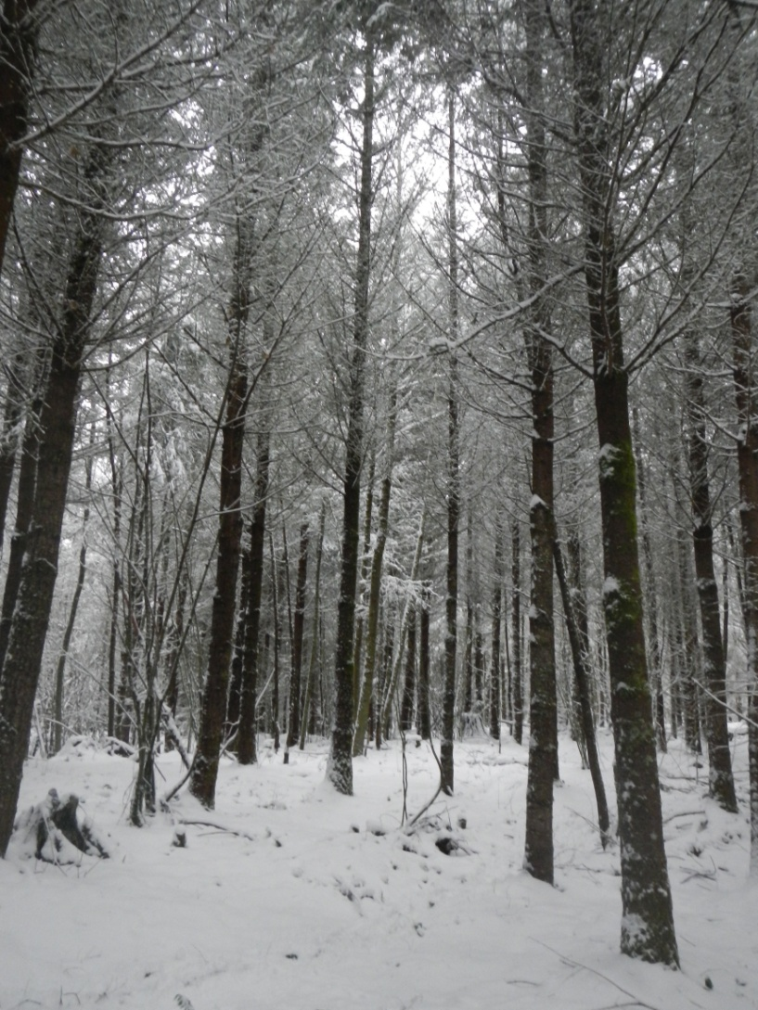
PITA Sample 1 (Vedder), ctd..

Slide 13
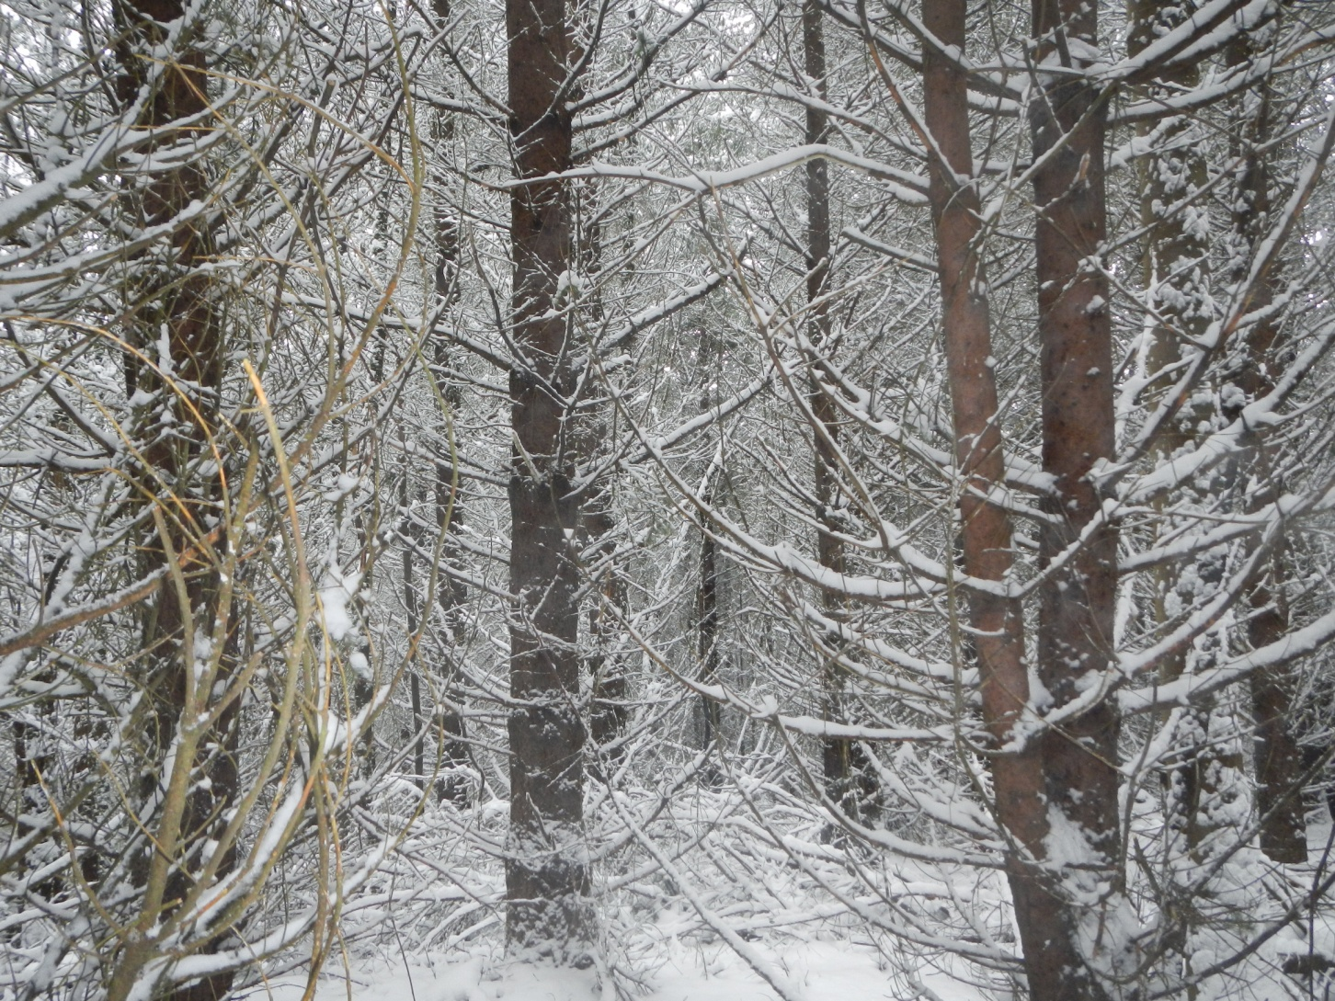
PITA Sample 2

Slide 14
Snow the great equalizer
Banana Belt
Fires Rehab
Squamish

Slide 15
Lessons Learned
Ensure that you hire someone who has done this before.
Ensure you have longer time lines than you need.
Take advantage of other Districts
Go slow
Check your assumptions
Thanks

Slide 16
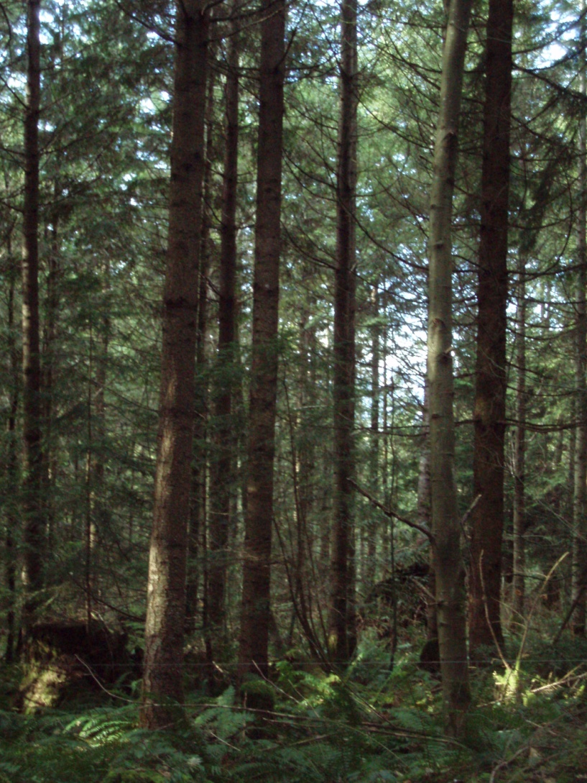
Questions

